Slide 1
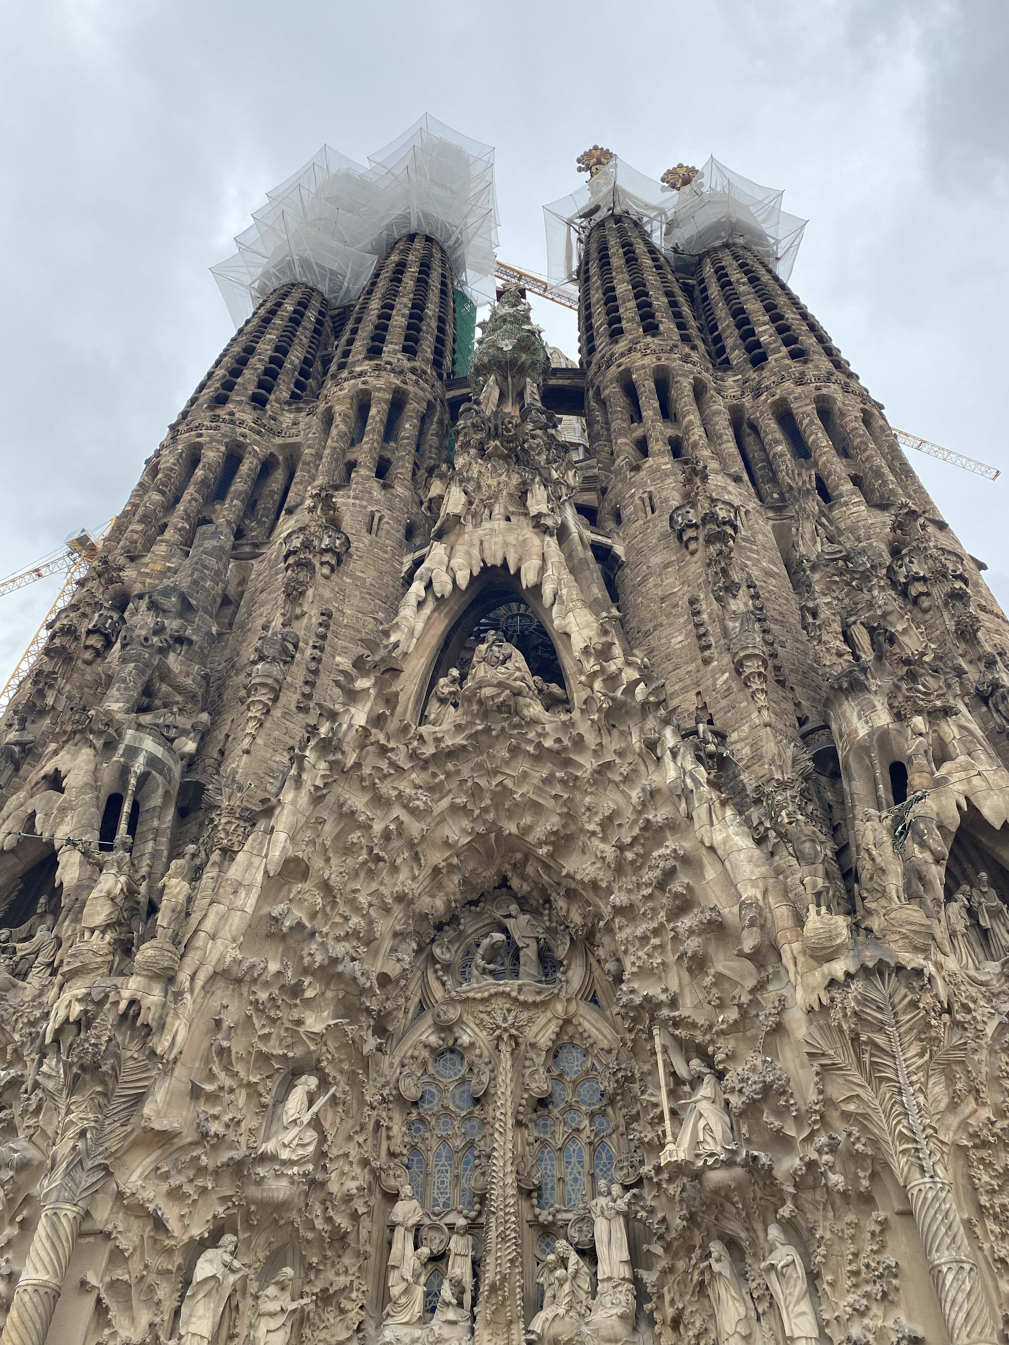
THIS?
Gaudi decided to
finish the
Nativity gate…

Slide 2
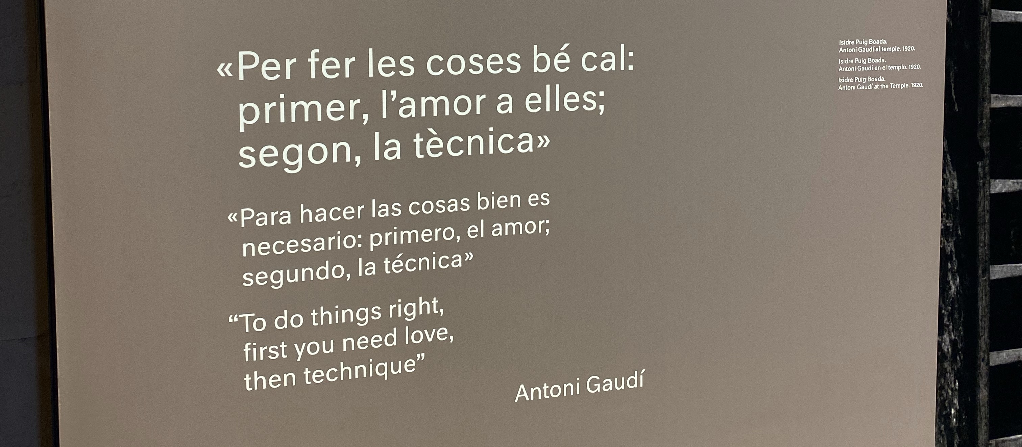
THIS?
All you need is …
❤️

Slide 3
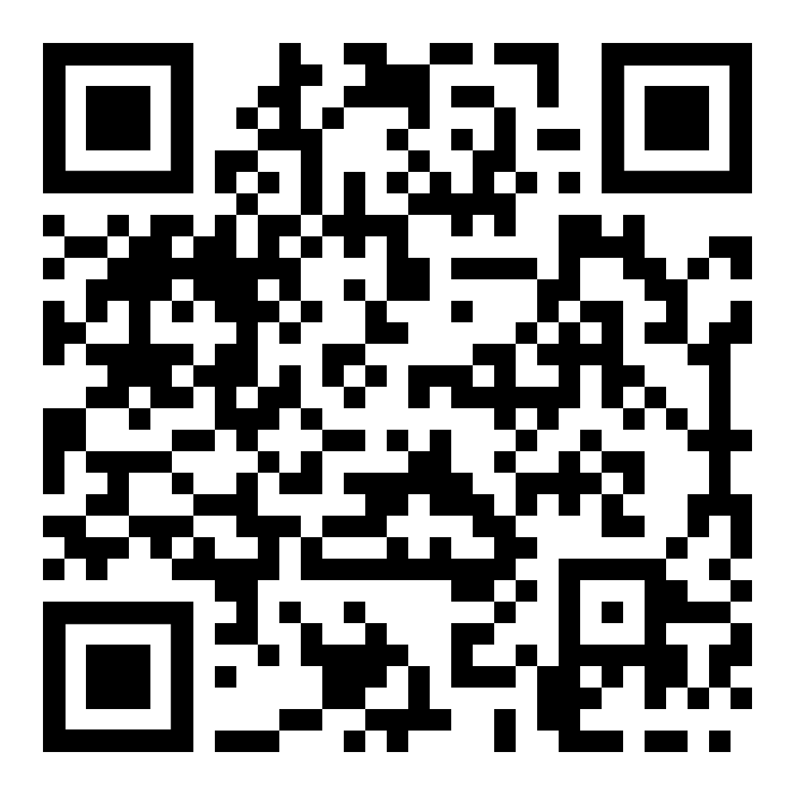
THIS?
Q&A

